Slide 1







Soft Solutions
About
Our Team
Presentation
Our GitHub
Expertise and Passion at Your Service

Slide 2






Our Team
We are a team of software engineering students passionate about building innovative solutions. With diverse skills in coding and problem-solving, we collaborate to develop high-quality applications. Driven by curiosity and teamwork, we embrace challenges and new technologies to create impactful software.
Soft
Solutions

Slide 3
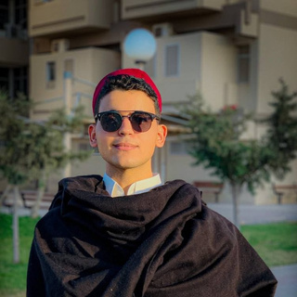


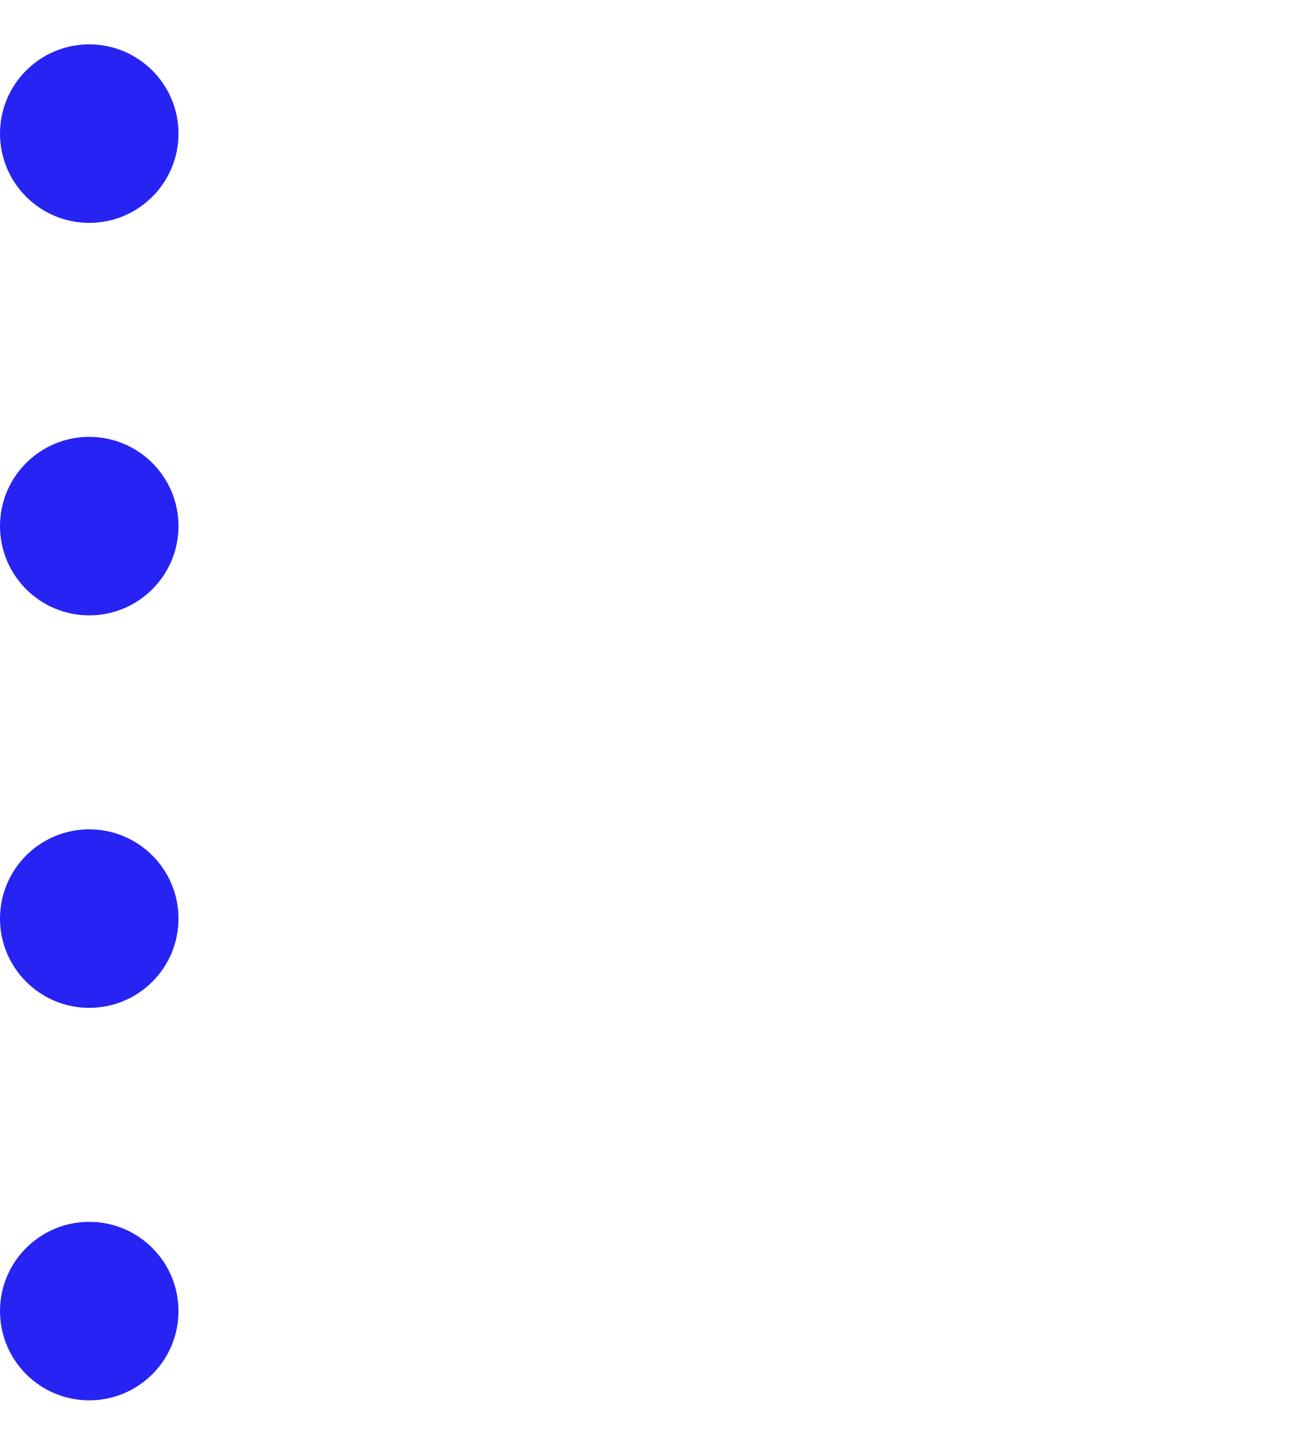
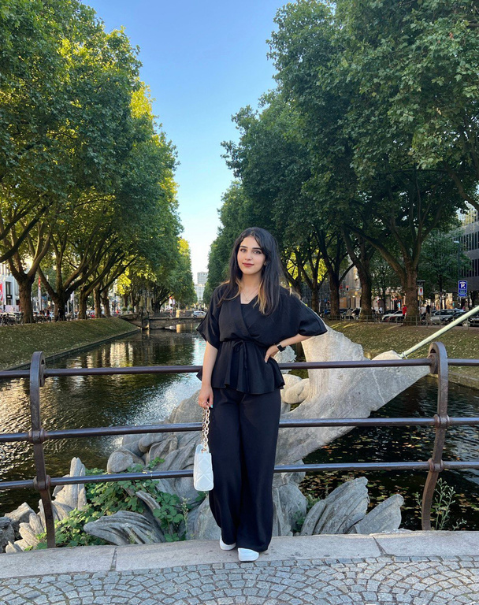
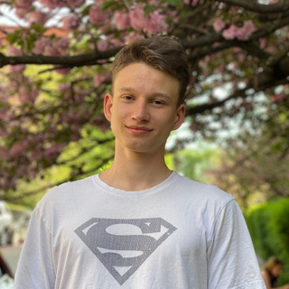
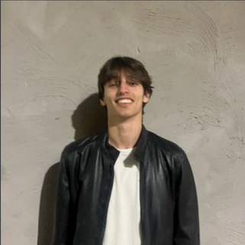
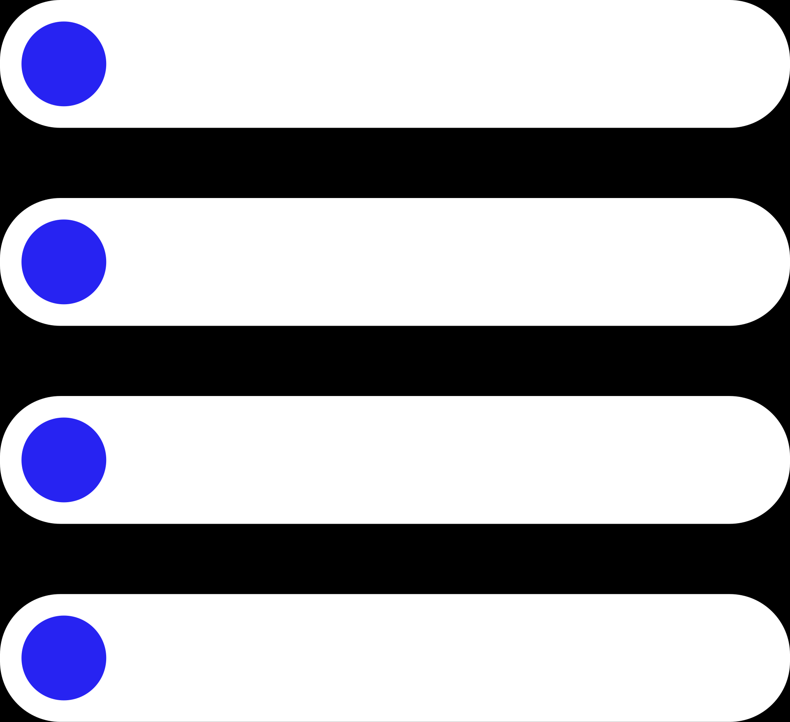

Our Team Members
Yaseen Almahayshi
Georgi
Beev
Sorin Rammo
Developer
Developer
Developer
Lorin Rammo
Andrii Nazarkevych
Héctor
Hernández
Developer
Creative Manager
Developer
Soft
Solutions

Slide 4
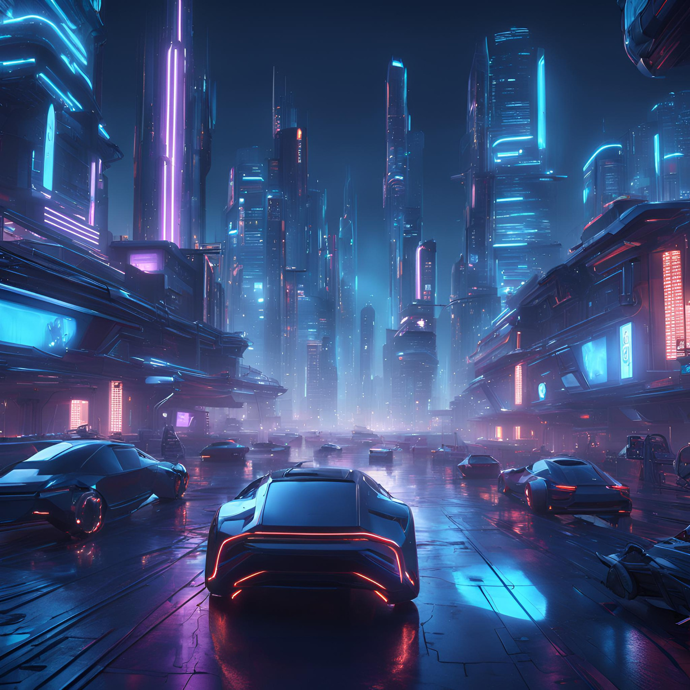

Soft Solutions
Our project
Our project focuses on developing a simple but functional inventory tool within Unreal Engine 5.5, designed for use in video games or architectural visualization. The tool allows users to pick up, store, and discard 3D assets in a first-person playable environment.

Slide 5

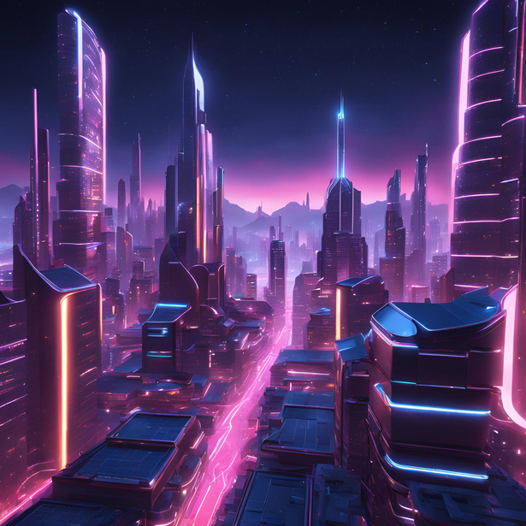
To achieve this, we will:
1
Source 3D assets from Quixel Megascans and import them into Unreal Engine.
2
Set up shaders and textures for the assets.
3
Build the inventory system using Unreal Blueprints (visual scripting) or C++ for optimized performance.
4
Deliver a fully interactive first-person level where users can manage 3D assets seamlessly.
Soft
Solutions

Slide 6
Keep in Touch with Us
Héctor Hernández
Phone
+34 601 32 93 41
Email
hector.hernandez-sanchez@edu.rtu.lv
Office
Lorin Rammo
Address
Ķīpsalas iela 6a, Rīga, LV-1048
Phone
+49 17629375943
Website
www.softsolutions.com
Email
Lorin.rammo@edu.rtu.lv
Soft
Solutions

Slide 7
Thank you!
any questions ?

